Slide 1
Empirical Project Overview TIØ4317 Empirical and Quantitative methods in Finance
Problem statement
Can stock market returns, as measured by the S&P 500 index, be explained using time series data on nonfarm payrolls and the federal funds rate?
Empirical analysis
Data
ARIMAX
GARCH
Conclusion
Sourced from the US Federal Reserve Economic Data
Two exogenous explaining variables: Federal funds rate and nonfarm payroll employment
One explained variable: The S&P 500 index
10 years of monthly time series data
Good framework for financial time series data
Indicates high impact of statistical significance from payroll employment
Indicates low impact of statistical insignificance from federal funds rate
Good framework for modelling time-varying volatility
Indicates the same results as ARIMAX model, however with higher confidence.
Indicates a high degree of volatility persistence
A 1% increase in payroll numbers gives 1.5-2% increase in MoM S&P 500 returns
The FFR⁽¹⁾ data needs to be preprocessed better
The GARCH model is preferred due to superior volatility modelling
Note: (1) Federal funds rate

Slide 2
Problem statement | What do I want to research?
Can stock market returns, as measured by the S&P 500 index, be explained using time series data on nonfarm payrolls and the federal funds rate?
This report investigates whether expectations to macroeconomic variables such as employment growth and interest rates can serve as explaining variables of market behavior. Interest rates and employment are two leading macroeconomic variables, as employment is a strong indicator of the current state of the economy and the federal funds interest rate is a tool for adjusting future activity.
Since direct data on market expectations (e.g., futures-implied rate expectations or labor forecasts) is difficult to obtain and quantify, the analysis uses the actual month-over-month changes in nonfarm payrolls and the federal funds rate as proxies for market expectations. This approximation can be justified by the relatively short forecast horizon and the tendency of market expectations to be fairly precise with near-term outcomes.
This problem delves into the world of statistical models for time series explanation and forecasting and aims to make use of several key concepts from the curriculum in TIØ4317.

Slide 3
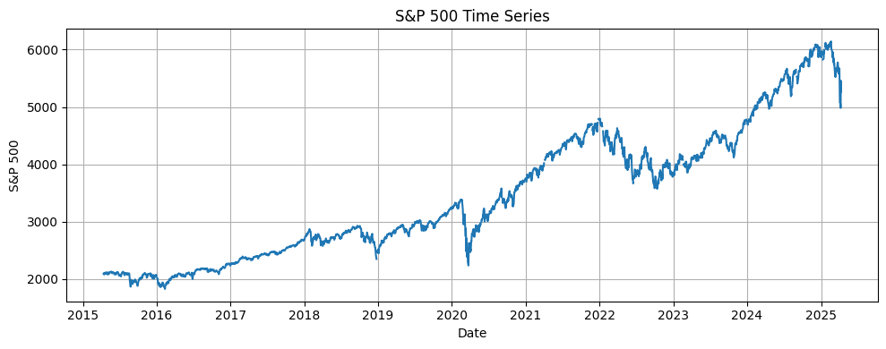
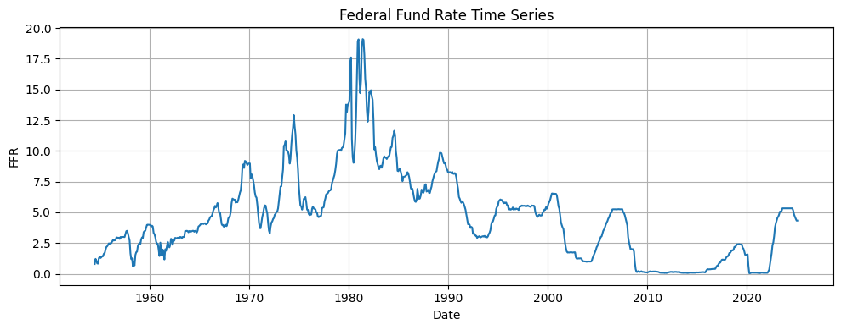
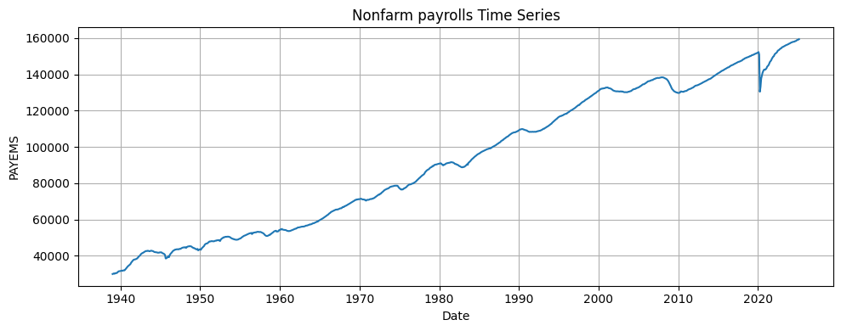
Data | I have sourced three datasets from the US Federal Reserve Economic Data (FRED)
SP500
(S&P 500)
FEDFUNDS
(Federal funds deposit rate)
PAYEMS
(Non-farm employment numbers)
Indexed data
Daily frequency
Apr 2015 - Apr 2025
Dataset on the value of the S&P 500 index, an index consisting of the 500 most important equities in the US
Percentage data
Monthly frequency
Jan 1957 - Apr 2025
Dataset on the value of the US federal funds deposit rate, as decided by the Federal Reserve
Absolute data
Monthly frequency
Jan 1939 - Apr 2025
Dataset on the number of employed Americans, ex. The more seasonal agricultural sector
SP500 Plot
FEDFUNDS Plot
PAYEMS Plot

Slide 4
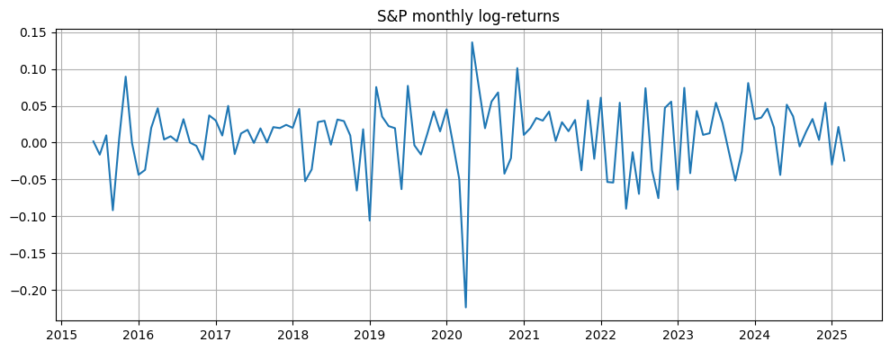
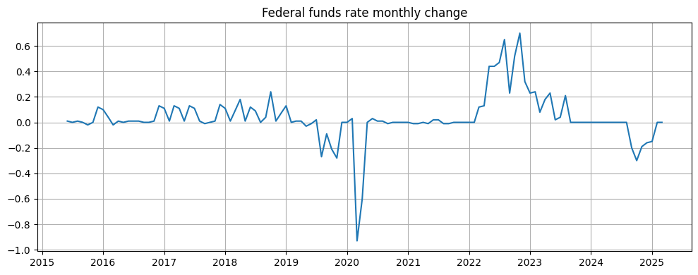
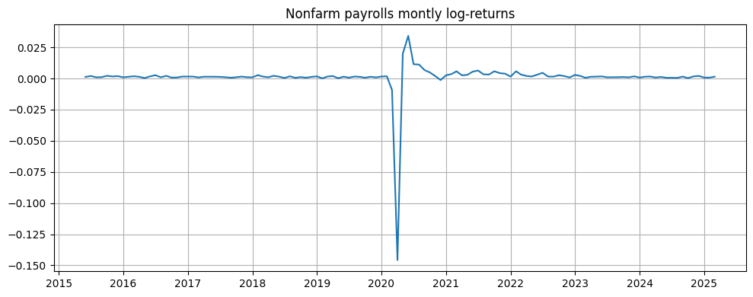
Data | To be compatible for statistical modelling, the data had to be transformed and standardized
SP500
(S&P 500)
FEDFUNDS
(Federal funds deposit rate)
PAYEMS
(Non-farm employment numbers)
Transformation steps:
Downsampling to monthly frequency
Applying log-returns
Log-returns have been applied to address stationarity and normality in returns
Transformation steps:
Applying first differences
To better capture the effects of monetary policy shocks, the month-over-month first difference has been used
Transformation steps:
Applying log-returns
As with the SP500 dataset, log-returns have been applied to address stationarity and normality in returns
Transformed SP500 Plot
Transformed FEDFUNDS Plot
Transformed PAYEMS Plot

Slide 5
Empirical analysis | Using two models for statistical explanation
ARIMAX
GARCH
The AutoRegressive Integraged Moving Average with Exogenous variables (ARIMAX(p, d, q)) model is a framework for modelling financial time series, building on the ARMA(p, q) model by incorporating differencing and exogenous variables.
Well suited for the task because of three main reasons:
Captures autocorrelation patterns
Accounts for residual non-stationarity not captured by the log-transformation
Explicitly incorporates exogenous variables, i.e. FEDFUNDS and PAYEMS
The Generalized AutoRegressive Conditional Heteroskedasticity (GARCH(p, q)) model is a framework for modelling time varying volatility in financial time series.
Well suited for the task because of two main reasons:
Captures volatility clustering and time-varying risk
Better inference on exogenous variables due to separation of drift and volatility modelling

Slide 6

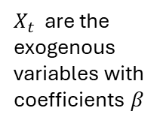

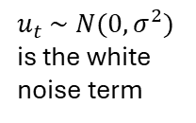

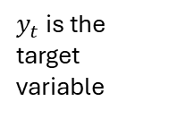


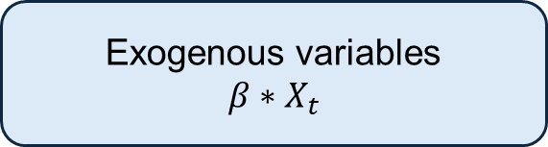
Empirical analysis | The ARIMAX model
General formula
$$φ\left(L\right){\left(1−L\right)}^{d}∗y_{t}=μ+θ\left(L\right)u_{t}+β∗X_{t}$$
Explanation
$μ$ is the drift of the process
$L$ are the lag variables such that $L^{i}$ is equivalent to $y_{t−i}$ or $u_{t−1}$
AR
Autoregression
$$φ\left(L\right)y_{t}$$
$y_{t}$ is the target variable
Captures the relationship between the current value and its lag values (preceding values)
I
Differencing
$${\left(1−L\right)}^{d}$$
Removes non-stationarity in the time series by computing the difference of degree d
MA
Moving Average
$$θ\left(L\right)u_{t}$$
$u_{t} \sim N(0,σ^{2})$ is the white noise term
Captures the impact of past errors (shocks) on the current value
X
$X_{t}$ are the exogenous variables with coefficients $β$
Exogenous variables
$$β∗X_{t}$$
Captures the impact of external variables (i.e. macroeconomic variables) on the target

Slide 7
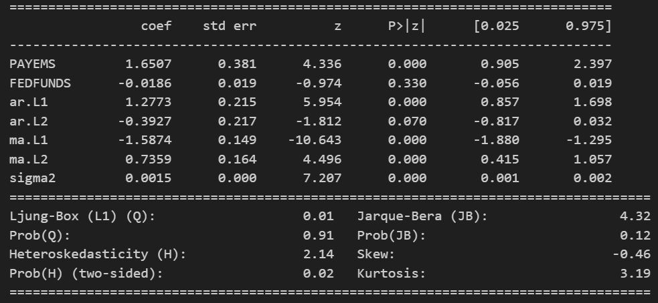
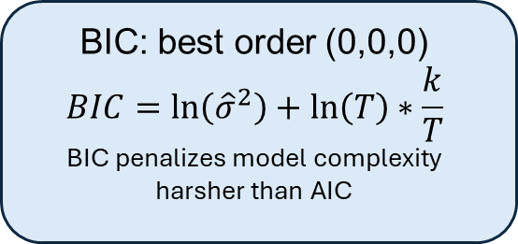
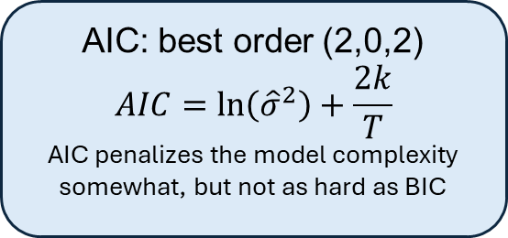
Empirical analysis | The ARIMAX model – model selection and results
Information criterion
Results from ARIMAX(2,0,2)
AIC: best order (2,0,2)
$$AIC=\ln\left({\hat{σ}}^{2}\right)+\frac{2k}{T}$$
AIC penalizes the model complexity somewhat, but not as hard as BIC
BIC: best order (0,0,0)
$$BIC=\ln\left({\hat{σ}}^{2}\right)+\ln\left(T\right)∗\frac{k}{T}$$
BIC penalizes model complexity harsher than AIC
PAYEMS has a positive and statistically significant impact (p < 0.01) on S&P 500 returns, with a 1% increase in PAYEMS leading to a 1.65% in stock returns, ceteris paribus
FEDFUNDS has a negative impact on stock returns, however the results are not statistically significant (p = 0.33)
The final model was selected using the AIC criterion, as I deem the model complexity of (2,0,2) to be acceptable

Slide 8



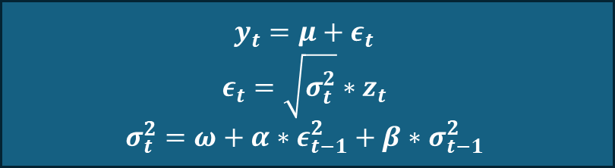
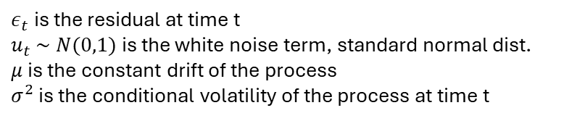
Empirical analysis | The GARCH(1,1) model
General formula
$$y_{t}=μ+ε_{t}$$
$$ε_{t}=\sqrt{σ_{t}^{2}}∗z_{t}$$
$$σ_{t}^{2}=ω+α∗ε_{t−1}^{2}+β∗σ_{t−1}^{2}$$
Explanation
$ε_{t}$ is the residual at time t
$u_{t} \sim N(0,1)$ is the white noise term, standard normal dist.
$μ$ is the constant drift of the process
$σ^{2}$ is the conditional volatility of the process at time t
$$ω$$
Constant volatility
Represents the long-term average volatility of the share price
$$α$$
Impact of past shocks
Captures the impact of recent shocks to the share price, as given by the last residual
$$β$$
Impact of past volatility
Captures the impact of recent volatility in the share price

Slide 9
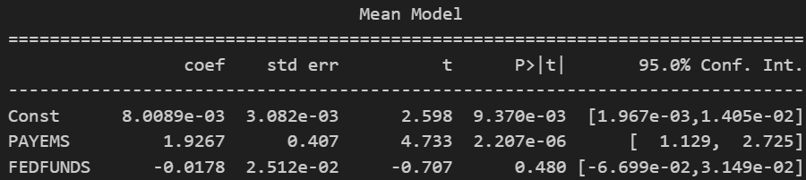
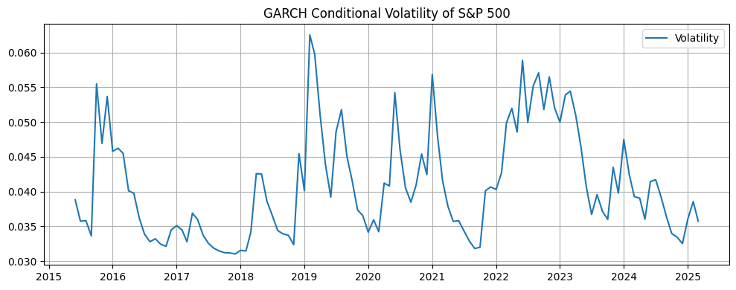
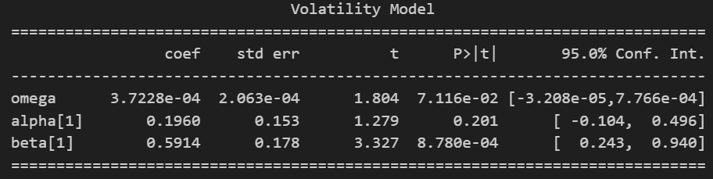
Empirical analysis | The GARCH model – results
Conditional volatility
Results from GARCH(1,1)
The conditional volatility estimated by the GARCH model implies a high degree of volatility clustering and heteroskedasticity, bolstering the need for a GARCH model to accurately model the SP500 development
PAYEMS has a positive and statistically significant impact (p < 0.01) on S&P 500 returns, with a 1% increase in PAYEMS leading to a 1.93% in stock returns, ceteris paribus
FEDFUNDS has a negative impact on stock returns, however the results are not statistically significant (p = 0.48)
Past volatility is persistent and explains nearly all present volatility

Slide 10
Conclusion | PAYEMS shows significant impact, FEDFUNDS needs better modelling to accurately capture known effect
PAYEMS impact
FEDFUNDS impact
Model selection
Both statistical models indicate a strong and statistically significant (p < 0.05) impact of change in payroll numbers on S&P 500 performance, namely a 1% change in payroll employment gives a 1.5-2.0% increase in returns. This empirical finding is rooted in the real world, as employment is a strong indicator of overall activity in the economy and thus also listed company performance.
Both statistical models indicate a vague negative impact, however statistically insignificant. It is widely known that the federal funds rate is highly impactful on markets, thus indicating that there are issues with how the data is presented to the model. I.e., the interest rate path is communicated by the fed well in advance, and changes are often priced into markets well before the same month
Although the ARIMAX model is able to capture the impact of the exogenous variables with high confidence, there are strong signs of heteroskedasticity in the data which implies that stronger volatility modeling is required. Evidently, the GARCH model is able to better isolate the true effect of the exogenous variables, further strengthening the credibility of the results from ARIMAX.
High impact, high statistical significance
Low impact, low statistical significance
GARCH required to accurately model volatility

Slide 11
References & LLM disclaimer
On LLMs
References
I have used LLMs throughout the report to explain me complex topics and debug my code, as I find that both can be very time-consuming activities, and as such I see that my work has become much more efficient by utilising LLMs such as ChatGPT.
I find that using LLMs for university assignments can be a two-sided sword, as it can both empower the user to focus on the more important tasks at hand and also give the user a way around actually learning and implementing the tasks.
Therefore, I have tried to contain LLM usage to the tasks that provide me the lowest marginal benefit compared to the time I spend on them.
Bollerslev, T. (1986). Generalized Autoregressive Conditional Heteroskedasticity. Journal of Econometrics.
Box, G. E. P., & Jenkins, G. M. (1970). Time Series Analysis: Forecasting and Control. Holden-Day.
Engle, R. F. (1982). Autoregressive Conditional Heteroskedasticity with Estimates of the Variance of UK Inflation. Econometrica.
Risstad, M. & Lavrutich, M. (2025). TIØ4317 Lecture Slides. The Norwegian University of Science and Technology.

